Slide 1
Grand Tours, Projection Pursuit Guided Tours, and Manual Controls
Weber YC, Huang
Data Science Institution, TMU

Slide 2
Summary
How do we find structure in multidimensional data when computer screens are only two-dimensional?
Multivariate Statistical Analysis with Data Visualization.
Ggobis (Noted that it can be use in R through package “rggobis”, see ggobis).
3 methods of Ggobis discussed.

Slide 3
Contents
1. Introduction
2. Tours
3. Using Tours with numerical methods
4. End notes

Slide 4
1. Introduction
Finding structure in multidimensional data when screen are only 2D?

Slide 5
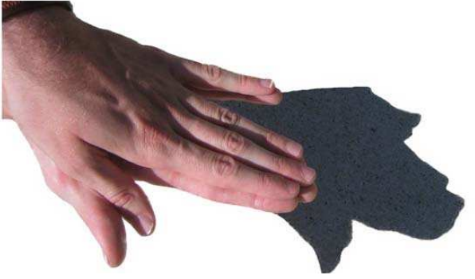
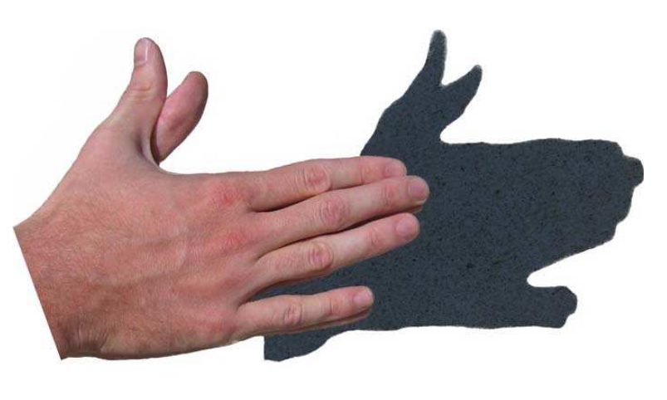
What is projection ? (1/2)

Slide 6
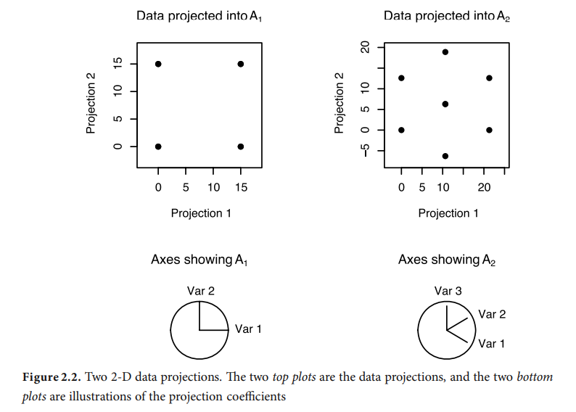
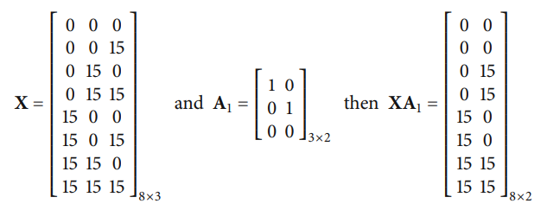
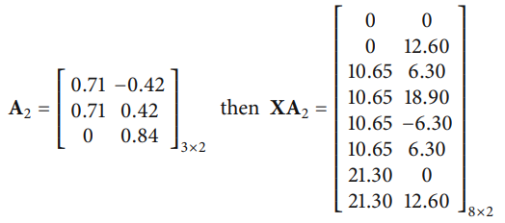
What is projection ? (2/2)
Mathematically, a projection of data is computed by multiplying an n x p data matrix (Dot Product)

Slide 7
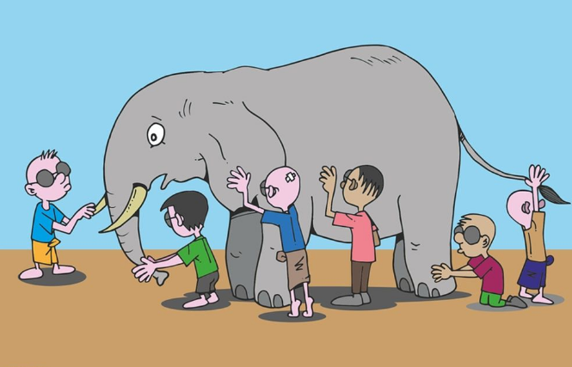
The blind men and the elephant

Slide 8
Interpolation methods
As they are commonly called as “tours”:
Tours in GGobi :
Grand tour
PP guide tour
Manual control
When we use tours, what are we looking for in the data? We search for data projections that are not bell-shaped and, hence, not normally distributed, for example, clusters of points, outliers, nonlinear relationships, and low-dimensional substructures.

Slide 9
2. Tours
Grand tour
PP guide tour
Manual control

Slide 10
Movement of a projection
Movement of a projection plane is achieved by selecting a starting plane and a target plane and computing intermediate planes using a geodesic interpolation. A geodesic is a circular path, which is generated by constraining the planar interpolation to produce orthonormal descriptive frames. This is the method used in GGobi.
Grand tour uses a random selection of target plane.
Guided tour quantifies the structure present in each projection and uses this to guide the choice of target plane.
Manual controls let the user choose the target direction by manipulating the values of projection coefficients.

Slide 11
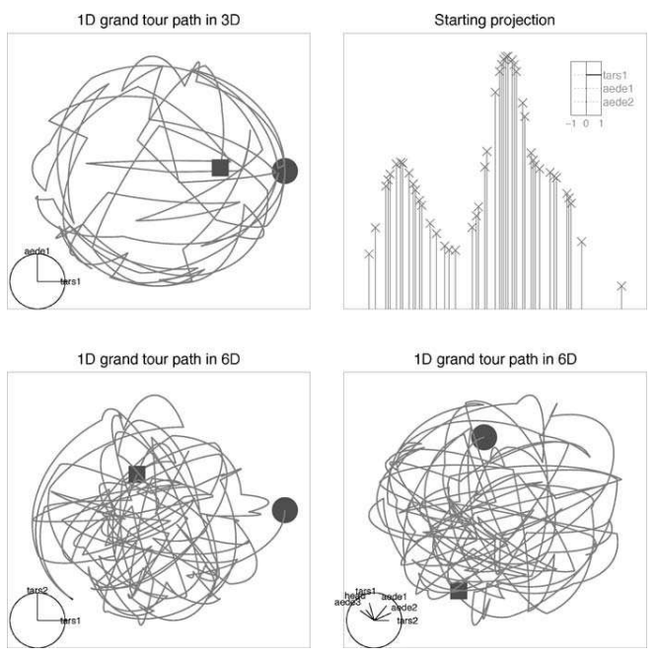
Grand Tour
Random selection : A frame is randomly selected from the space of all possible projections.

Slide 12
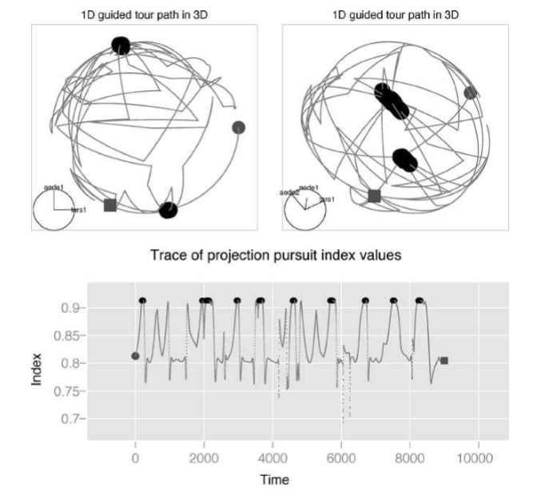
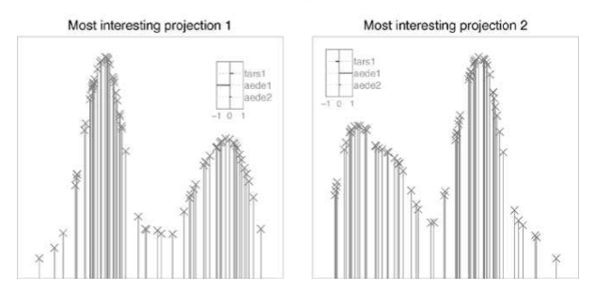
Projection Pursuit Guided Tour
PP index function
The optimization procedure is an important part of a PP guided tour.
holes, central Mass, and PCA

Slide 13
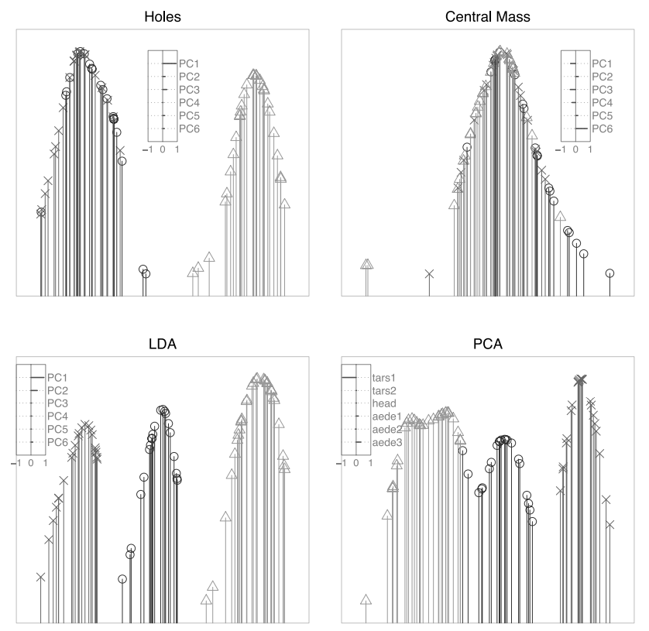
Manual Controls
manually rotate a single variable

Slide 14
3. Using Tours with numerical methods

Slide 15
Tours are useful when used along with numerical methods for certain data analyses.
Tours can help numerical approaches in many ways
Choose which of the tools at hand works best for a particular problem.
Understand how the tools work in a particular problem.
Overcome the limitations of a particular tool to improve the solution.

Slide 16
4. End notes

Slide 17
Tours support exploring real-valued data.
They deliver many projections of real-valued data in an organized manner, allowing the viewer to see the data from many sides.

